Slide 1
Privacy vs Security
ELG 2911
By: Eric Dam & Mahyar Gorji

Slide 2
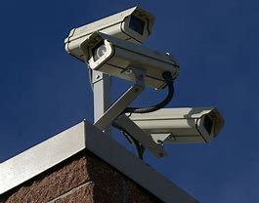
Background Information

Slide 3
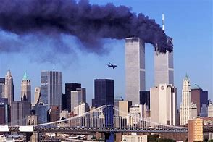
Background Information
Motive
Increases in surveillance from 911
Divide

Slide 4

Analysis

Slide 5
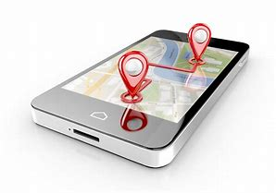
Types of Surveillance
Increase in usage
Many different methods
Emails
Cellular Tracking
PRISM Surveillance

Slide 6
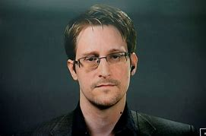
Case Study: Edward Snowden
Former Government employee
Released Classified Information
Ongoing Arrest

Slide 7
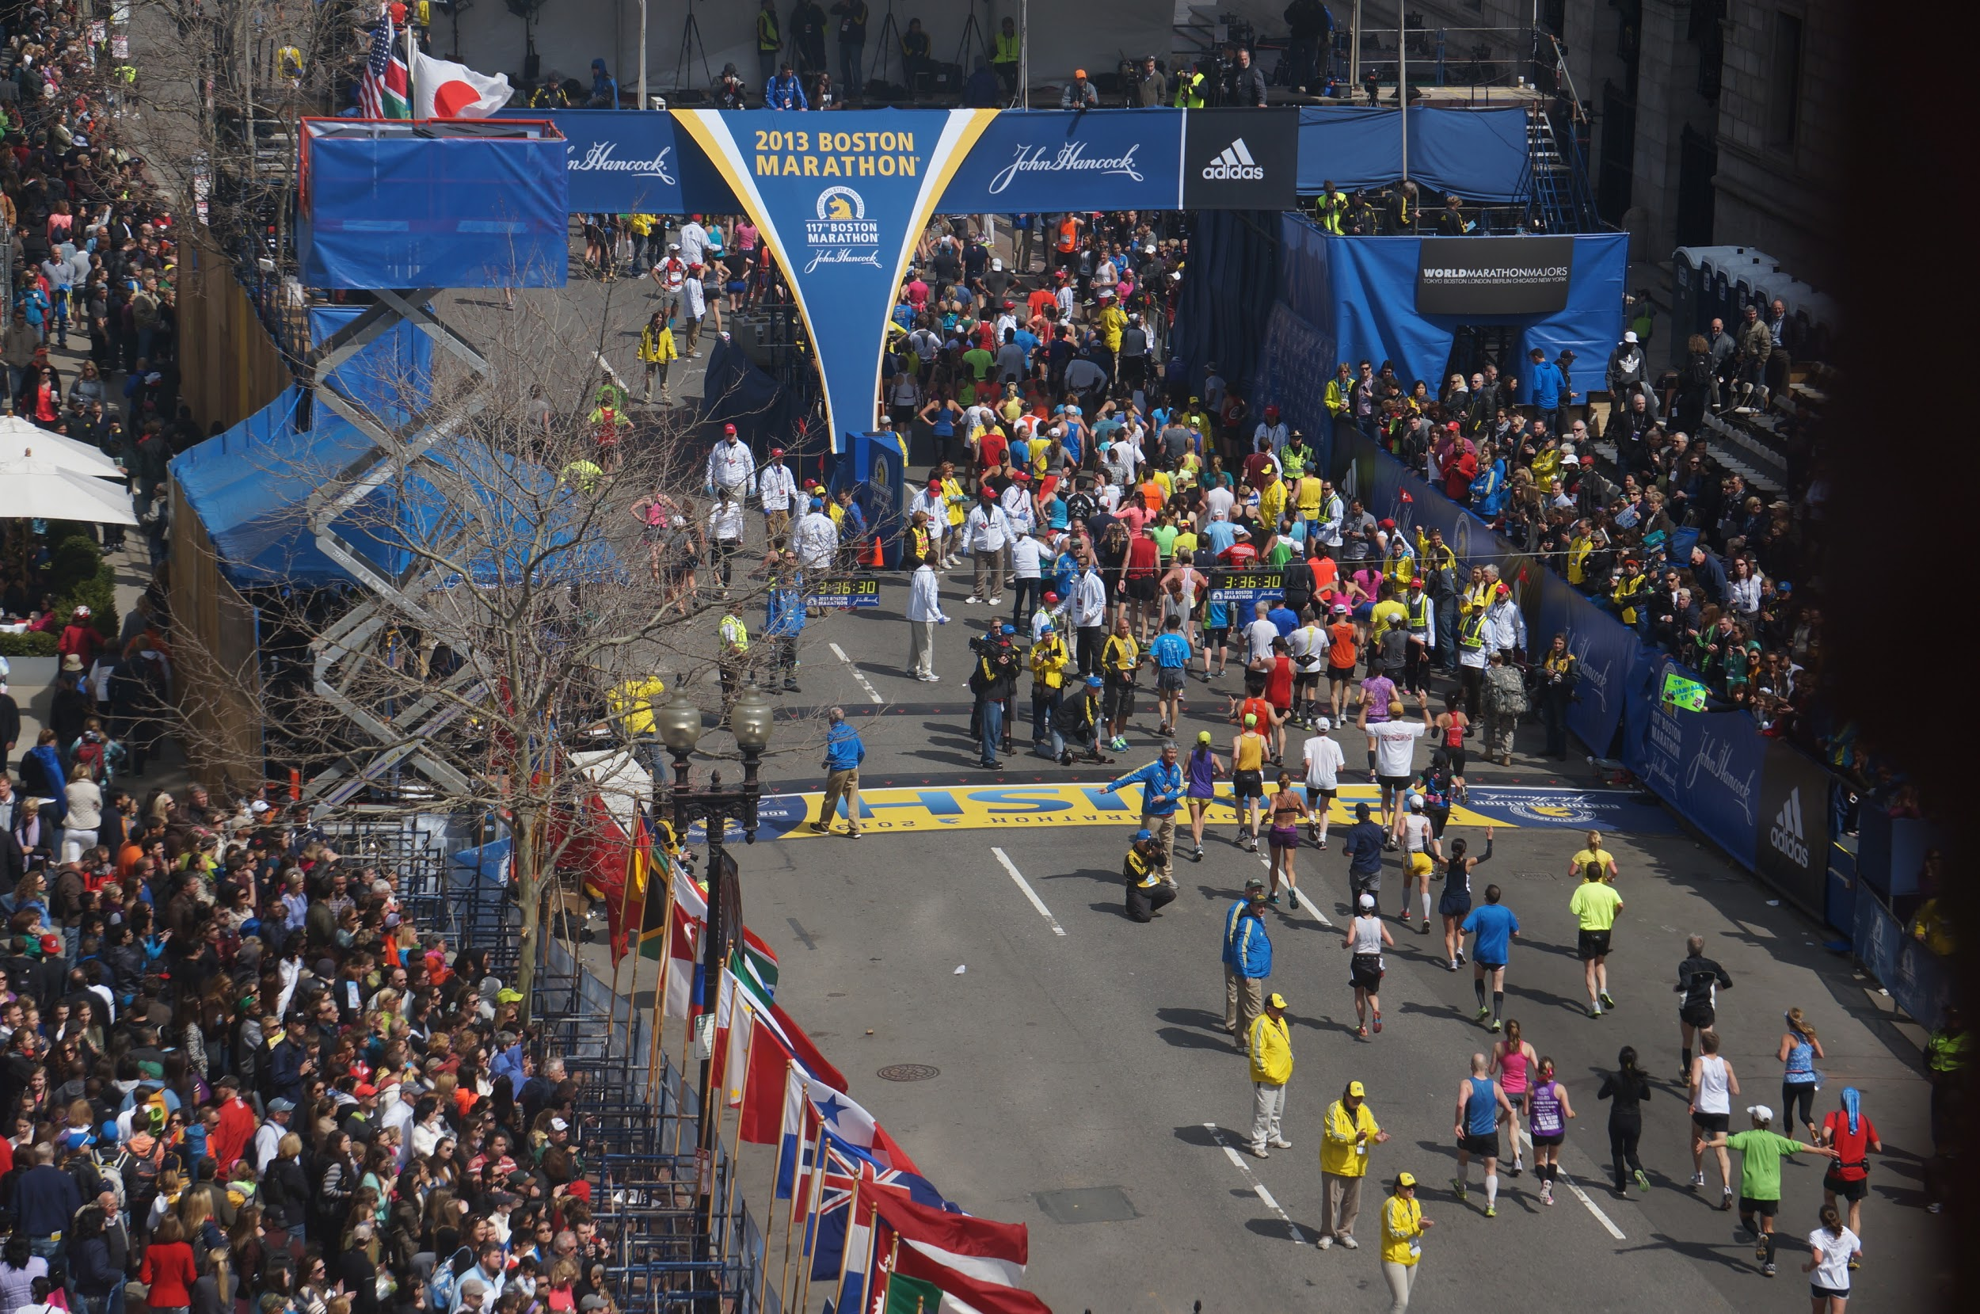
Security from Surveillance
Tracked perpetrators
Potential ineffectiveness
Boston Bombing incident

Slide 8
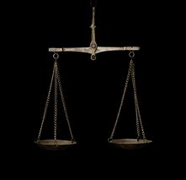
Where limitations should be placed
Potential Distrust
Privacy Act
Trust benefits in society

Slide 9
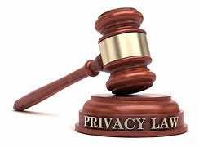
United States in comparison to other Countries
Privacy laws in the United States
Privacy laws in Canada

Slide 10
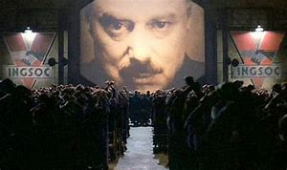
Benefits of Surveillance
Big Brother Doctrine
Automated Cameras
Cameras in the case of Security and Wrongdoings

Slide 11
Conclusion

